Slide 1


VALERO
BACKUP AND RESTORE TOOL
Name
Student ID
Email
January 2025
Aditya Guleria
101577843
aditya.guleria@georgebrown.ca
Prince Alben Uwizeye
101574777
princealben.uwizeye@georgebrown.ca

Slide 2
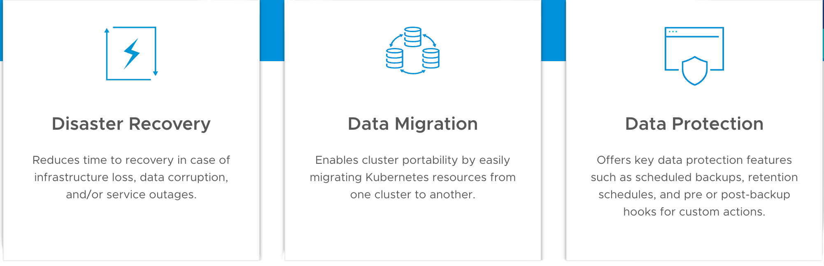
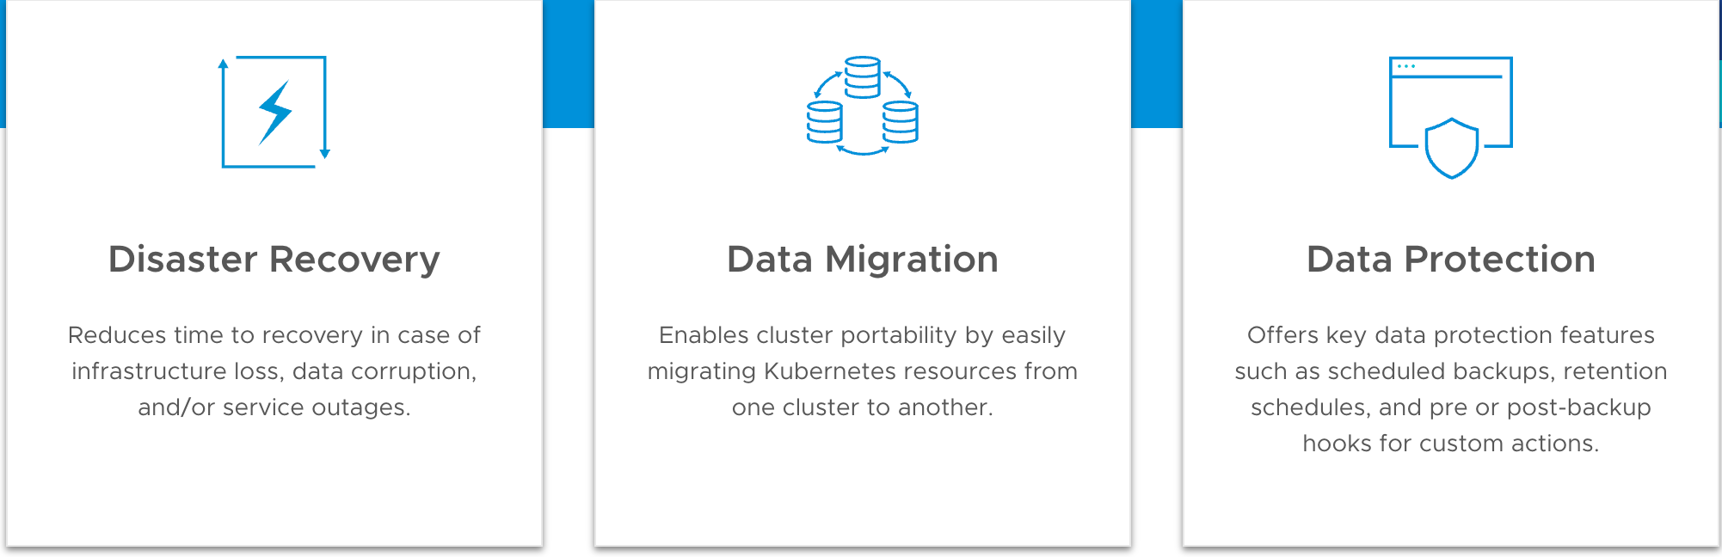
WHAT IS VALERO?
Velero is an open source tool to safely backup and restore, perform disaster recovery, and migrate Kubernetes cluster resources and persistent volumes.
2

Slide 3


WHY USE VALERO?
Ensures business continuity in case of cluster failure.
Facilitates seamless application migration.
Reduces complexity for cluster backups.
Works with any cloud provider (AWS, GCP, Azure etc.) and on-premises clusters.

Slide 4
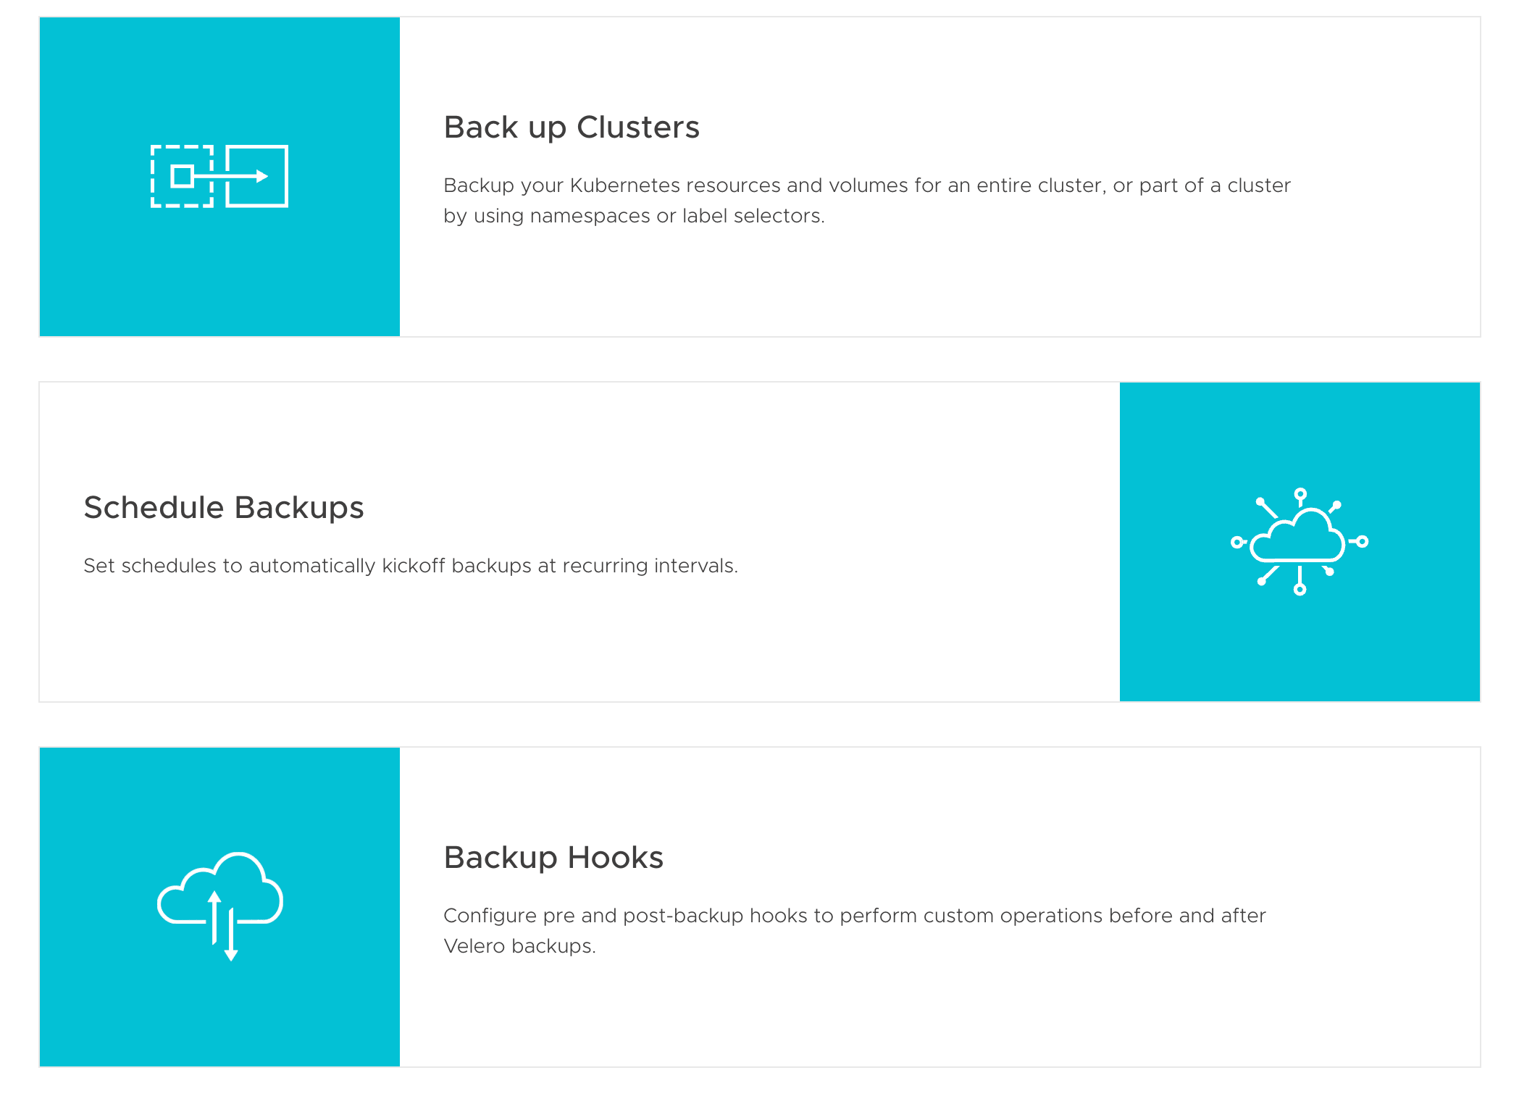
FEATURES
Back up Clusters
Backup your Kubernetes resources and volumes for an entire cluster, or part of a cluster by using namespaces or label selectors.
Schedule Backups
Set schedules to automatically kickoff backups at recurring intervals.
Backup Hooks
Configure pre and post-backup hooks to perform custom operations before and after Velero backups.
2

Slide 5

PRE-REQUISITES FOR VELERO
Kubernetes Cluster (EKS, GKE, Minikube etc.)
Velero CLI installed
Access to a backup storage provider (AWS S3, MinIO, etc.)
RBAC permissions configured for Velero in the cluster

Slide 6
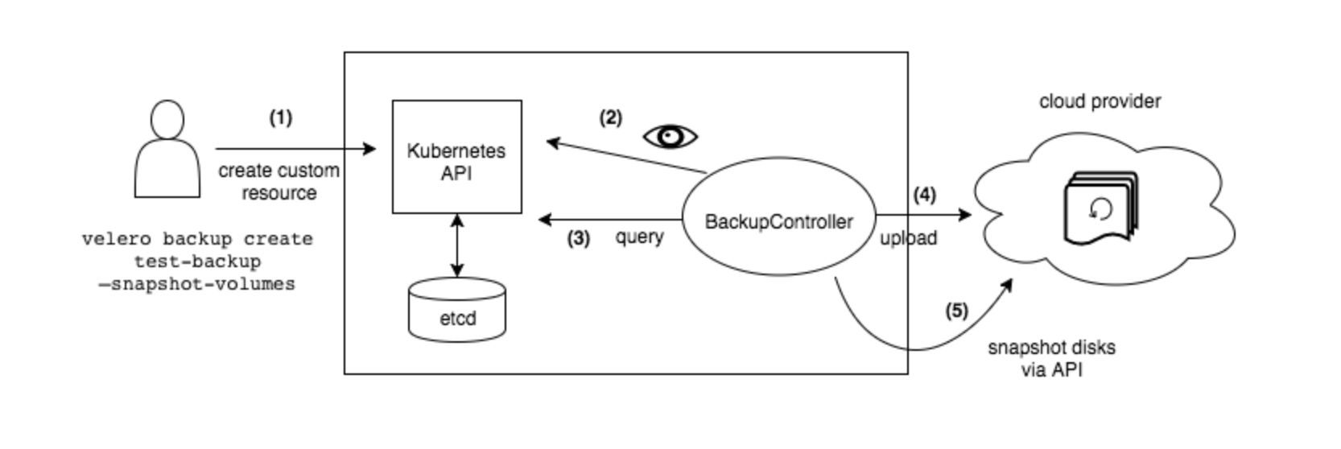
BACKUP WORKFLOW
The Velero client makes a call to the Kubernetes API server to create a Backup object.
The BackupController notices the new Backup object and performs validation.
The BackupController begins the backup process. It collects the data to back up by querying the API server for resources.
The BackupController makes a call to the object storage service – for example, AWS S3 – to upload the backup file.

Slide 7
COMMANDS
Backup:
velero backup create todo-app-backup --include-namespaces=todo-demo
List Backups:
velero backup get
Restore:
velero restore create --from-backup todo-app-backup

Slide 8
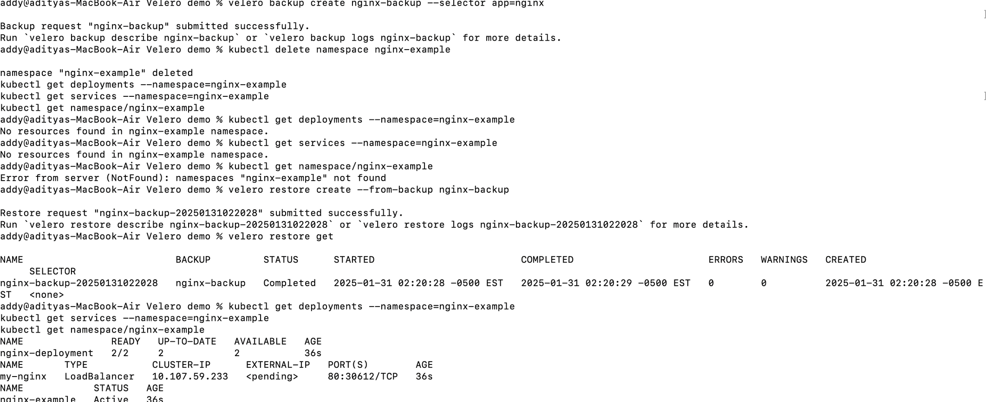
DEMO

Slide 9

DISASTER RECOVERY
Set up a daily backup
velero schedule create <SCHEDULE NAME> --schedule "0 7 * * *"
2. A disaster happens and you need to recreate your resources.
3. Update your backup storage location to read-only mode to prevent it from created or deleted during the restore process.
4. Create a restore with your most recent Velero Backup:
velero restore create --from-backup <SCHEDULE NAME>-<TIMESTAMP>
10

Slide 10
ADVANTAGES
Open-source and free.
Cloud-agnostic (works with all major cloud providers).
Simple to install and configure.
Supports both application configurations and persistent volumes.
10

Slide 11
CONCLUSION
Velero simplifies Kubernetes cluster management by providing robust backup and restore functionality.
It’s a critical tool for disaster recovery and cluster migrations.
Easy to set up and works seamlessly with most cloud and local storage providers.
10

Slide 12
THANK YOU
Name
Student ID
Email
Jan 2025
Aditya Guleria
101577843
aditya.guleria@georgebrown.ca
Prince Alben Uwizeye

